Slide 1
Building a Recommendation Engine – An empirical case study
Neetu Pundir (s0567477@htw-berlin.de)
Department: Project Management And Data Science
23.03.2021
1st Supervisor: Prof. Dr. Veit Wohlgemuth
2nd Supervisor: Prof. Dr. Tilo Wendler

Slide 2
Agenda of Day
Background of study
Problem Statement
Aim and objective
Research Question
Dataset description
Models and Evaluation metrics
Content based filtering
Collaborative Filtering CF
SVD
SVD++
Deep learning
Evaluation metrics: Hit ratio & RMSE
Summary
Conclusions and Recommendation

Slide 3
Background of Study
In internet realm users are equipped with massive information which sometime bewildered them with ample amount of choices.Every ecommerce sites, YouTube, Netflix, Amazon, LinkedIn et al. uses RS.
So it is necessary to properly process feedback and reviews of users for good suggestions
Recommendation system (RS) is collaboration of algorithms that focuses on suggesting relevant information to users
RS collect information from browsing action of users, their age, gender, demographic information, product specification, their rating pattern and interpret them to suggest new items
Using this information RS minimise customers’ list of selection from huge content

Slide 4
Problem statement
This research aims to
develop various recommendation models such as content based filtering, collaborative filtering, SVD, Deep learning and then evaluate their performance using Hit ratio, RMSE and MAE
suggest top movies similar to the movie entered by user ( using movie description)
recommend list of similar movies that are liked by similar users
predict ratings of unrated movies

Slide 5
Aim and Objective
This research aims to analyze best recommendation technique among content based, collaborative filtering, SVD and Deep learning.
With the prime objective
to help companies to increase the sales of more diverse products,
increase loyal customer, reduce customer churn
to help users in effortless browsing of products
recommend popular as well as unwatched/ unrated movies

Slide 6
Research Question
Recommending top movies that are similar to movies searched by users (using movie metadata)
Recommending similar movies that group of similar users have watched
Predicting ratings of unrated movies
Evaluating the performance of multiple recommendation techniques and analyze the best recommendation techniques.

Slide 7
MovieLens Dataset description
Files | Dataset Shape | Feature Name | Unique Feature | Missing Value
movies.csv as movies | (62423,3) | movieId, title, genres | movieId | No
ratings.csv as ratings | (25000095,4) | userId, movieId, rating, timestamp | No | No
tags.csv as tags | (1093360,4) | userId, movieId, tag, timestamp | No | 0.0014% in tag feature
links.csv as links | (62423,3) | movieId,imdbId, tmdbId | movieId | 0.17% (tmdbId)
genome-scores.csv as genome_scores | (15584448,3) | movieId, tagId, relevance | tagId | No
genome-tags.csv as genome_tags | (1128,2) | tagId, tag | tagId | No
Dataset Features | Datatype
userId, movieId, imdbId, tagId, timestamp | Int64
Title, Genres, Tag | Object
Rating, tmdbId, relevance | Float64

Slide 8
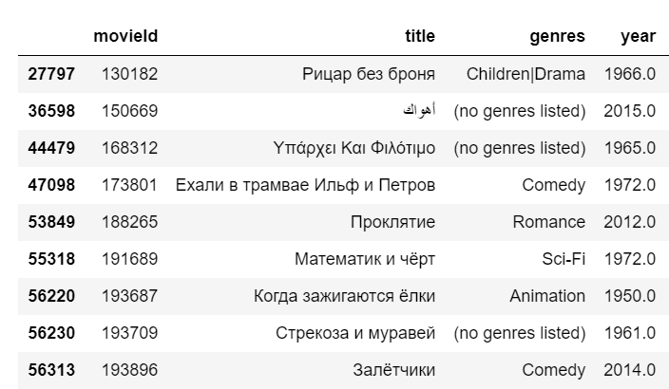
Exploratory Data Analysis
Movies with title other than English

Slide 9
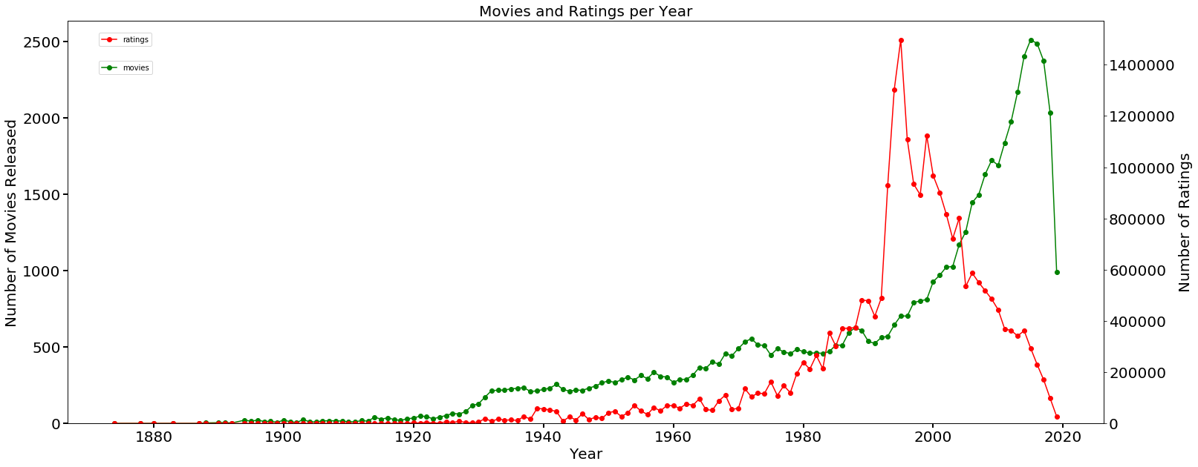
Exploratory Data Analysis
Number of movies released and ratings per year [09.jan.1995-21.nov.2019]

Slide 10
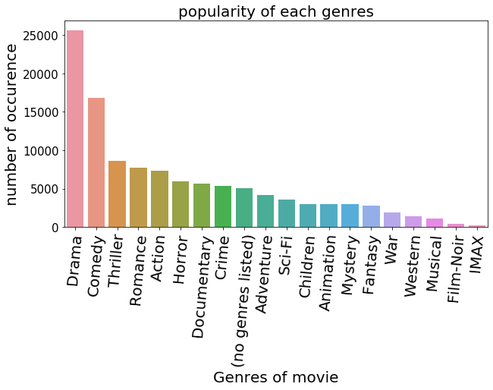
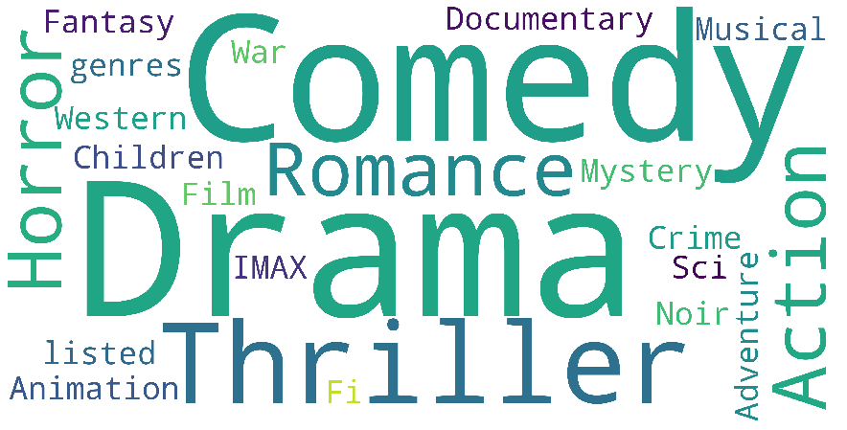
Exploratory Data Analysis
Popular genres of movies

Slide 11
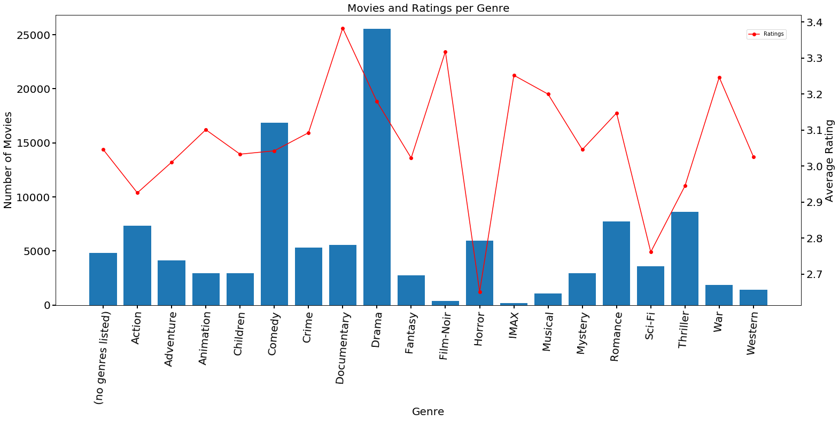
Exploratory Data Analysis
Trend of movies and Ratings per Genres

Slide 12
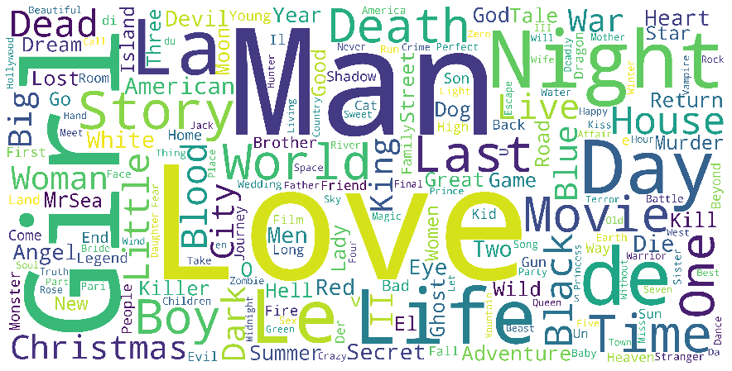
Exploratory Data Analysis
Frequently used words in title of movies

Slide 13
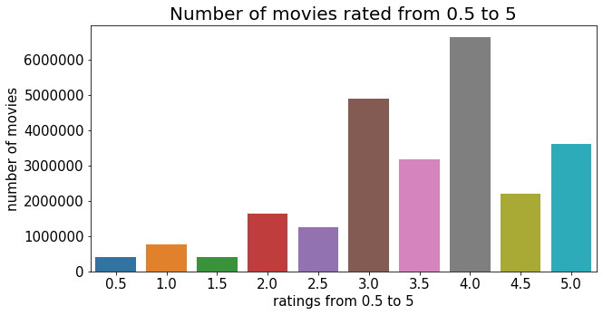
Exploratory Data Analysis
Ratings of movies

Slide 14
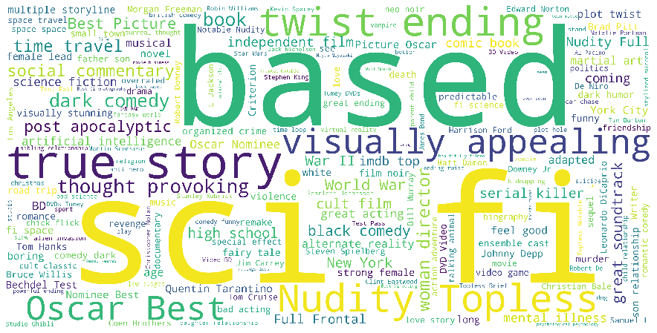
Exploratory Data Analysis
Frequently used tags for movies

Slide 15
Types of Recommendation System
Recommendation system
Collaborative filtering (CF)
memory-based CF
Hybrid filtering
weighted Hybrid
mixed hybrid
model-based CF
User-based CF
Item-based CF
Content-based Filtering
Matrix Factorization - SVD, SVD++
Deep Learning
KNN clustering

Slide 16
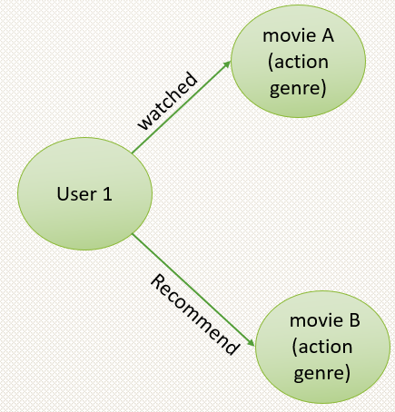
Content based Recommendation system
This model recommend movies using information from description of movies and user profile.
Such as if user1 seen movie A (action genre) then system will suggest another movie B of similar genre.
In this technique user preference is matched with item in database and then most similar item is suggested

Slide 17
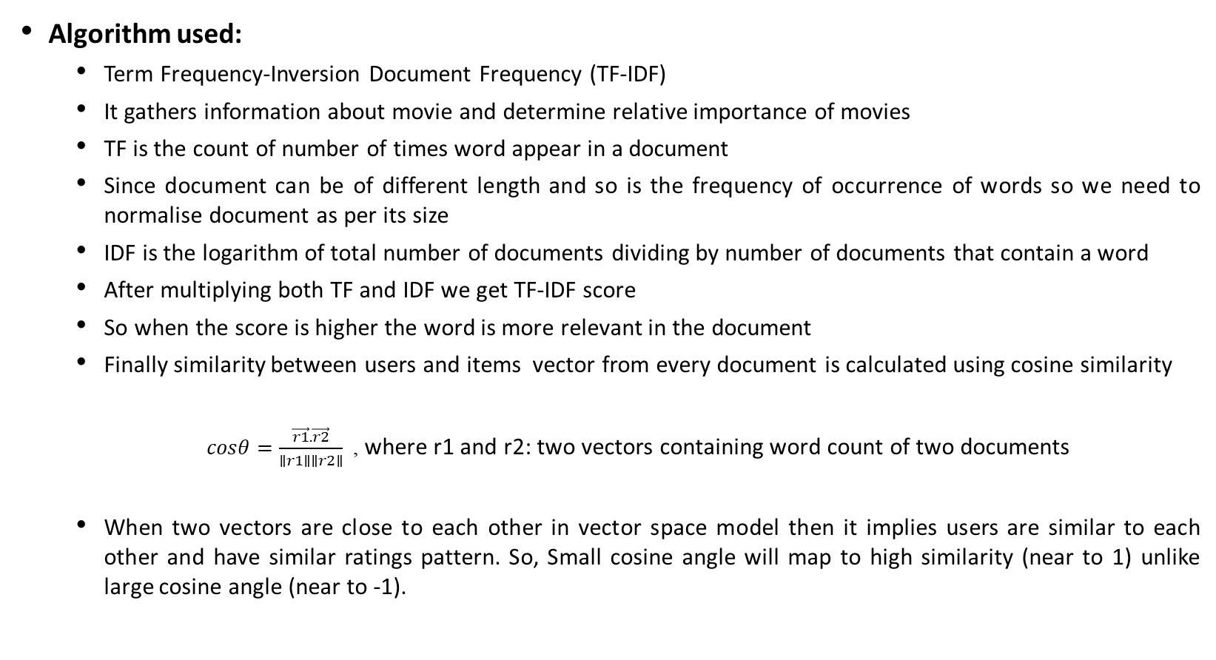
Content based Recommendation system
Algorithm used:
Term Frequency-Inversion Document Frequency (TF-IDF)
It gathers information about movie and determine relative importance of movies
TF is the count of number of times word appear in a document
Since document can be of different length and so is the frequency of occurrence of words so we need to normalise document as per its size
IDF is the logarithm of total number of documents dividing by number of documents that contain a word
After multiplying both TF and IDF we get TF-IDF score
So when the score is higher the word is more relevant in the document
Finally similarity between users and items vector from every document is calculated using cosine similarity
$cosθ=\frac{\vec{r1}.\vec{r2}}{∥r1∥∥r2∥}$, where r1 and r2: two vectors containing word count of two documents
When two vectors are close to each other in vector space model then it implies users are similar to each other and have similar ratings pattern. So, Small cosine angle will map to high similarity (near to 1) unlike large cosine angle (near to -1).

Slide 18

Content based Recommendation system
Metric used
To evaluate performance hit ratio is used
$Hit ratio= \frac{number of hits}{total number of hits+ faults}∗100\%$
When a user entered a search and system predict similar results then it hit is counted as 1 otherwise fault is counted as 1.

Slide 19
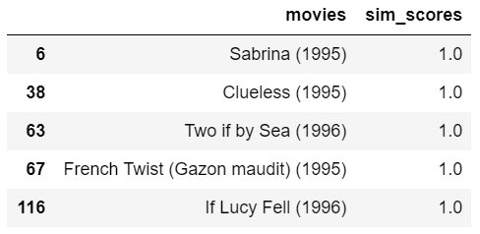
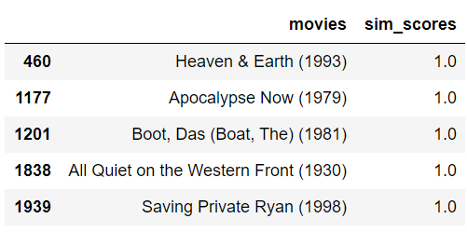
Content based Recommendation system
Results
Similarly, user who searched for “Saving Private Ryan (1998)" can also watch these movies
User who searched for "Nina Takes A Lover (1994)" can also watch these movies as they have also same genres

Slide 20
Content based Recommendation system
Evaluation Results: Hit ratio obtained for this recommendation system is
Hit: 89.64%
Fault: 10.35%
Limitation of content based Recommendation system
Only suggest movies that are close to certain movie
incapable of capturing varied tastes and provide recommendation across genres
This is not really “Personal engine” i.e., it doesn’t capture personal taste of user. Anyone querying for movies in content based will get same recommendation list as per genre detail of entered movies regardless of user profile and taste

Slide 21
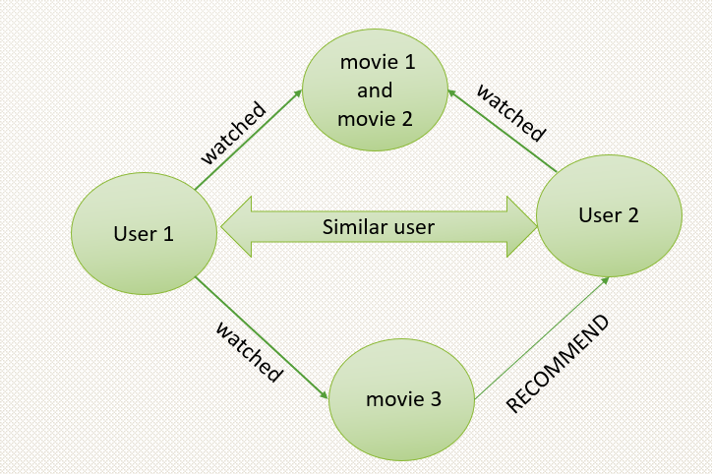
Collaborative filtering (CF)
This model takes users’ past action into consideration and correlate it with other users to make good suggestions.
It is further classified into
Memory based RS
User-user CF
Item-item CF
Model based RS
Matrix Factorization SVD
SVD++
Deep learning
Using KNN algorithms
Using Scikit learn packages

Slide 22
Memory based CF
Memory based CF looks for similar users or items to make movies recommendation. It is further classified into
1. User-User CF
In user-user CF, emphases is on finding the look alike users whose past rating pattern is similar to that of specified user and use their rating to recommend the movies that the specified user might like to watch.
It is very effective recommendation
Algorithm used for calculation of similarity: cosine similarity. Cosine similarity measures the cosine angle between two vectors A and B (users in this case) , two vectors are said to be similar when the angle between them is smaller

Slide 23
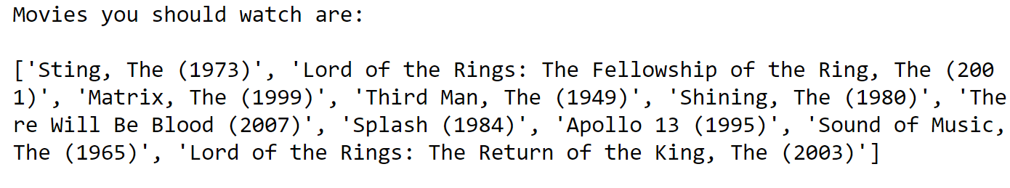
Memory based CF
List of movies that can be watched by user number=1696

Slide 24
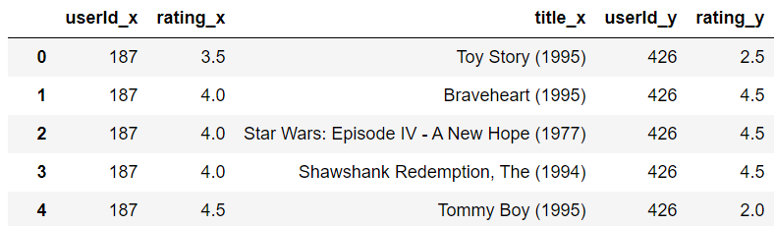
Memory based CF
Two users 187 and 426 are similar identical users and can watch following movies.

Slide 25

Memory based CF
2. Item- item CF
emphasis is on searching for lookalike items and recommend these similar items to the users who have similar rating pattern.
List of movies that can be watched by user number=162508

Slide 26
Collaborative filtering (CF)
Limitation
User-user CF is very time consuming as it need to compute every user pair information and also it require very strong parallelizable system for computation
It doesn't address cold-start problem i.e., when new user or new item present in the system with no rating history
It can't deal with sparse data (in case of ratings)
It only recommend popular items.

Slide 27
Model based Collaborative filtering
It focuses on reducing the dimension of large and sparse user-item matrix (consist of users and items)
For sparse matrix reducing the dimensions can improve performance of algorithm and helps to discover hidden correlation for more accurate results, helpful in removing redundant and noisy features that don't add value to data, helps in easy data storage and processing
This can be obtained by various techniques like Matrix factorization, clustering, Deep learning.
To implement model based collaborative filtering engine, packages of surprise library and scikit learn library are used.

Slide 28
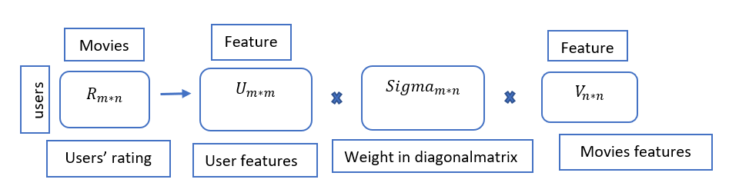
Model based Collaborative filtering: Matrix Factorization (MF) based algorithm
Singular Value Decomposition (SVD)
SVD decomposes a high rank matrix into best lower rank approximation of original matrix. It decomposes R into two unitary matrices and a diagonal matrix.
R: input rating matrix with n users and m movies
U: latent features of users extracted by PCA
Sigma: diagonal matrix to scale value
V: latent features of movies extracted by PCA
Therefore, U and V are used to reconstruct R
SVD widely used in building RS. It calculates the latent preferences of users and latent attributes of items from known rating to predict unknown ratings by dot product of user and item.

Slide 29
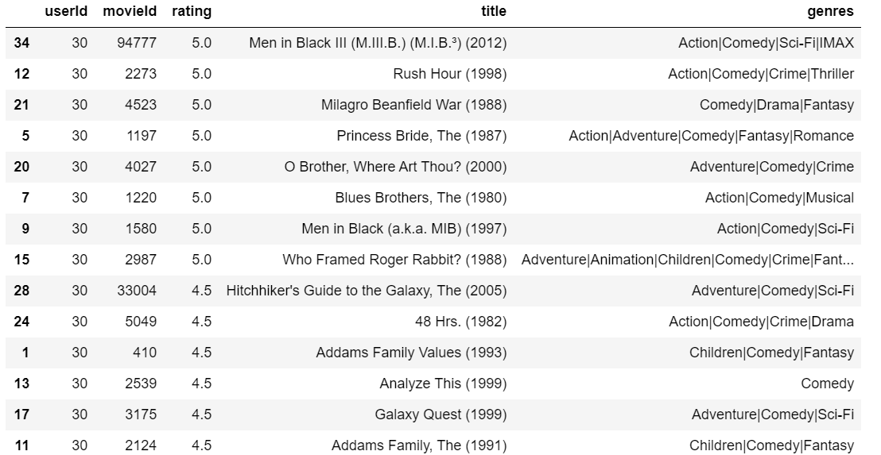
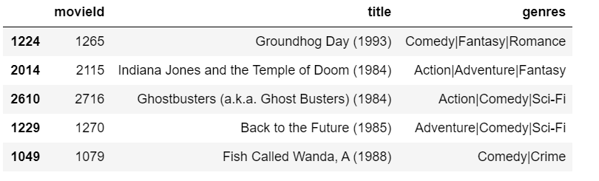
Results Singular Value Decomposition (SVD)
The list of already rated movies for user 30 are shown below:
Top 5 Recommendation for user 30

Slide 30
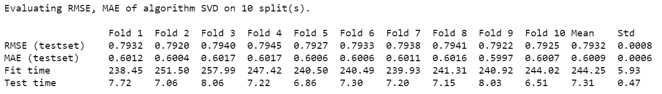
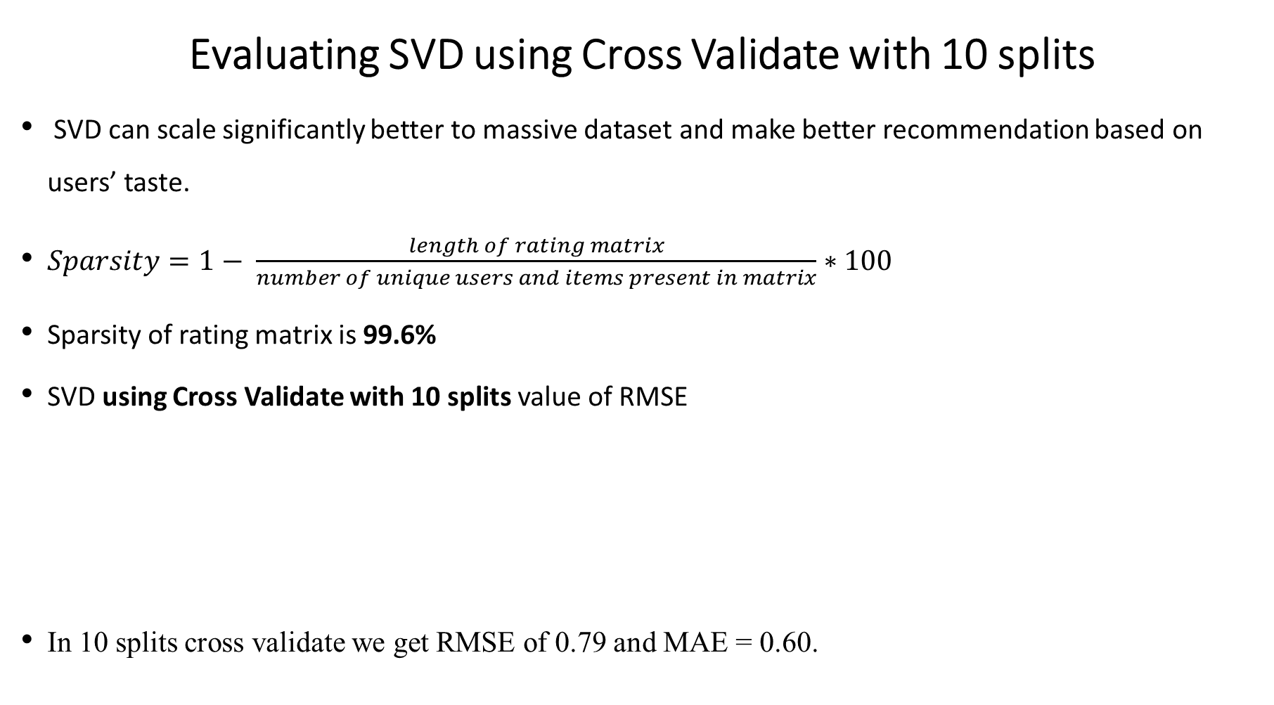
Evaluating SVD using Cross Validate with 10 splits
SVD can scale significantly better to massive dataset and make better recommendation based on users’ taste.
$Sparsity=1− \frac{length of rating matrix}{number of unique users and items present in matrix}∗100$
Sparsity of rating matrix is 99.6%
SVD using Cross Validate with 10 splits value of RMSE
In 10 splits cross validate we get RMSE of 0.79 and MAE = 0.60.

Slide 31
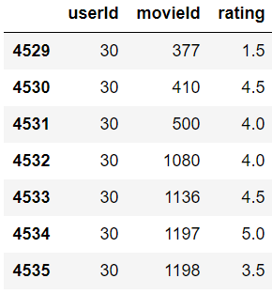

fit this trainset using to predict rating of assigned movies on the basis of other users rating pattern. It can be seen that userId 30 rated most of the movies 3.5, 4 and model predict estimated rating of 3.5 to this user for a random movieId 1574

Slide 32

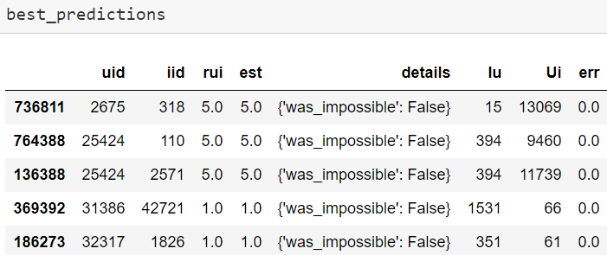
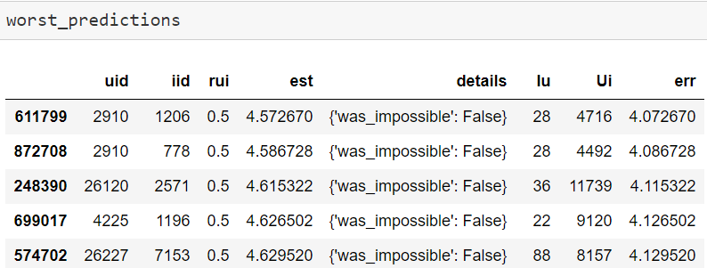
Evaluating SVD using Grid Search CV
Combination of best parameter is used to make prediction

Slide 33
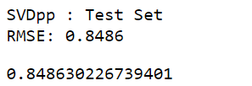
Evaluating SVD++
SVD++ consider both implicit and explicit feedback of users.
In our dataset implicit feedback is the movies that user selected to rate. So, this can help to reduce the rating matrix into binary matrix where ‘1’ given for rated movie and ‘0’ for unrated movies.
Limitation of Model based CF
Due to low rank approximation some meaningful signals might be lost.
Interpretability problem as a singular vector specifies a linear combination of all input columns or rows.
lack of sparsity when the singular vectors are quite dense

Slide 34
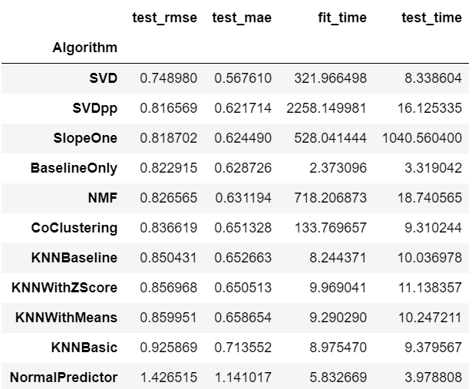
Model based CF using surprise library

Slide 35
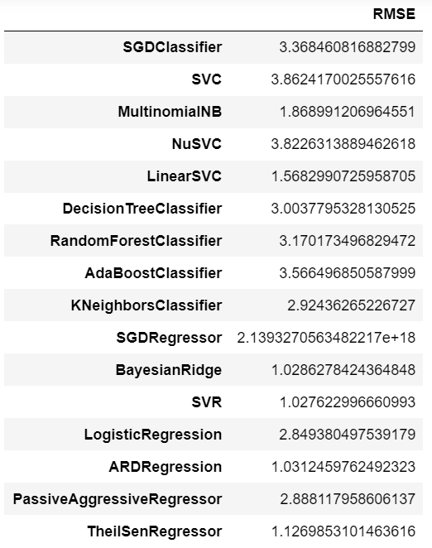
Model based CF using scikit learn library

Slide 36
Model based CF: comparing performance

Slide 37
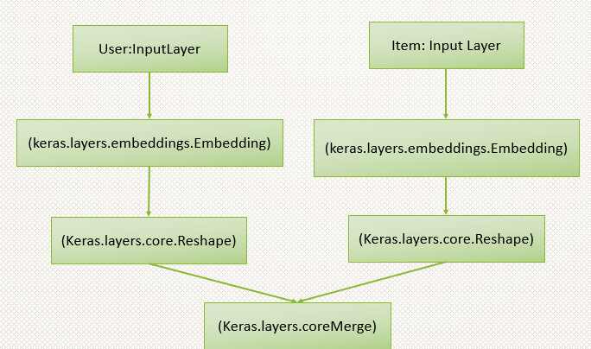
DEEP Learning Model
Similar to Matrix Factorization (MF) it also decomposed original matrix into two model matrices
Embedded matrix contain user latent features and movie latent features.
For specified user these latent features are searched in embedding matrix and then fed as input to linear and non-linear layers (multiple ReLu, linear or sigmoid layers)

Slide 38
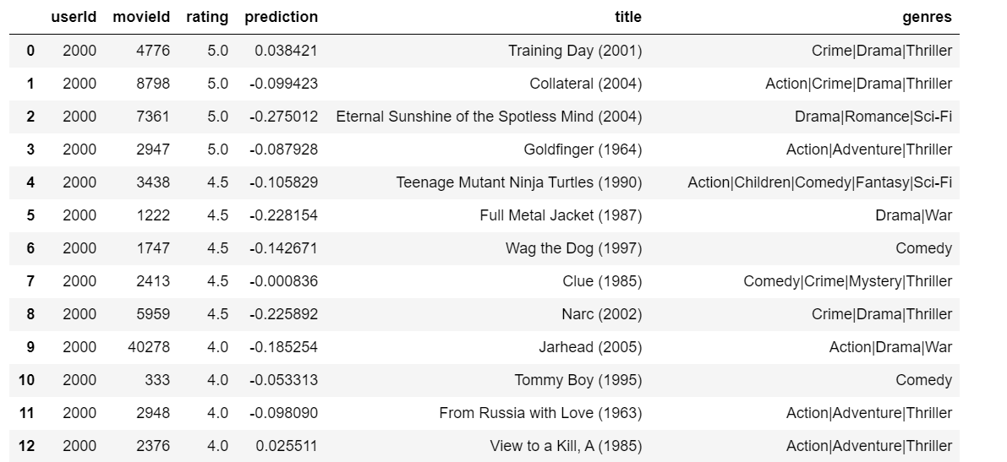
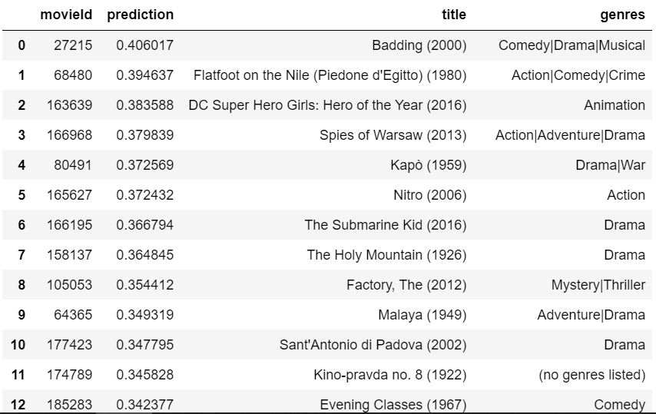
DEEP Learning Model
Results: deep learning trained model, predict the ratings that has already given by user 2000
predicting movies for user 2000

Slide 39
DEEP Learning Model
Evaluation:
RMSE obtained from training deep learning model for 10 epochs is 3.12.
Limitation:
Due to computational issues I have trained model only on 0.01% random sample of rating which leads to very higher value of RMSE
It can be improve by increasing data size and number of epochs
Also increasing number of linear and non-linear layers

Slide 40
Summary
Ideally hit ratio should between 95-99% and miss ratio between 1-5% for good prediction. In content-based filtering hit ratio is nearly 89% which means there are 89% chances that this model suggests a good movie list to user as per title entered by them. So, content-based recommendation gives quite a descent list of movies that have similar genres as per the movie title entered by user.
Memory based CF provide list of similar items and similar users on the basis of similarity score calculated using pairwise distance between ratings given by each user for different items.
RMSE for SVD and SVDpp models are less than 0.70 compare to KNN and basic algorithms.
Among SKlearn classifier, SVR has lower RMSE of 1.
RMSE obtained from training deep learning model for 10 epochs is 3.12

Slide 41
Conclusion and recommendation
Exploratory data analysis gives an insight into dataset like sparsity in dataset, trends of rating as per genres, release year of movie, word cloud to count the occurrence of words in title, tags, genres
Content-based provide quite good list of movies as they have Hit ratio nearly 89%.
SVD and SVDpp are best predicting engines with low RMSE 0.74 with 10 and 4 CV splits in our case.
When model-based CF is implemented using surprise algorithms it is found that SVDpp predict (RMSE of 0.72) better compare to other algorithms like SlopeOne, KNNWithMeans etc.
Similarly, when model-based CF is implemented using SKlearn classifiers, it is observed that SVR predict better (RMSE 1) compare to other algorithms like AdaBoost classifier, KNeighbors classifier, SVC, Gradient boosting classifier etc.

Slide 42
Conclusion and recommendation
Recommendation
In future we can explore the following open questions:
What effect does multi-model recommendation engine have on segregated genre level data
What effect does hybrid model have on recommendation system, where models are tailored as per user and multiple other underlying factors
What effect does addition movie attributes like actor, producer, sales, geographical location, language et al have on recommendation system
What effect does additional user information like age, country, gender et al have on recommendation system
What effect does deep learning model have on full 25 million rating data points merged with movie metadata on recommendation system

Slide 43
Thank you

